Slide 1

Problems on PMF and PDF

Slide 2
Reference
Data
Youtube
Code

Slide 3
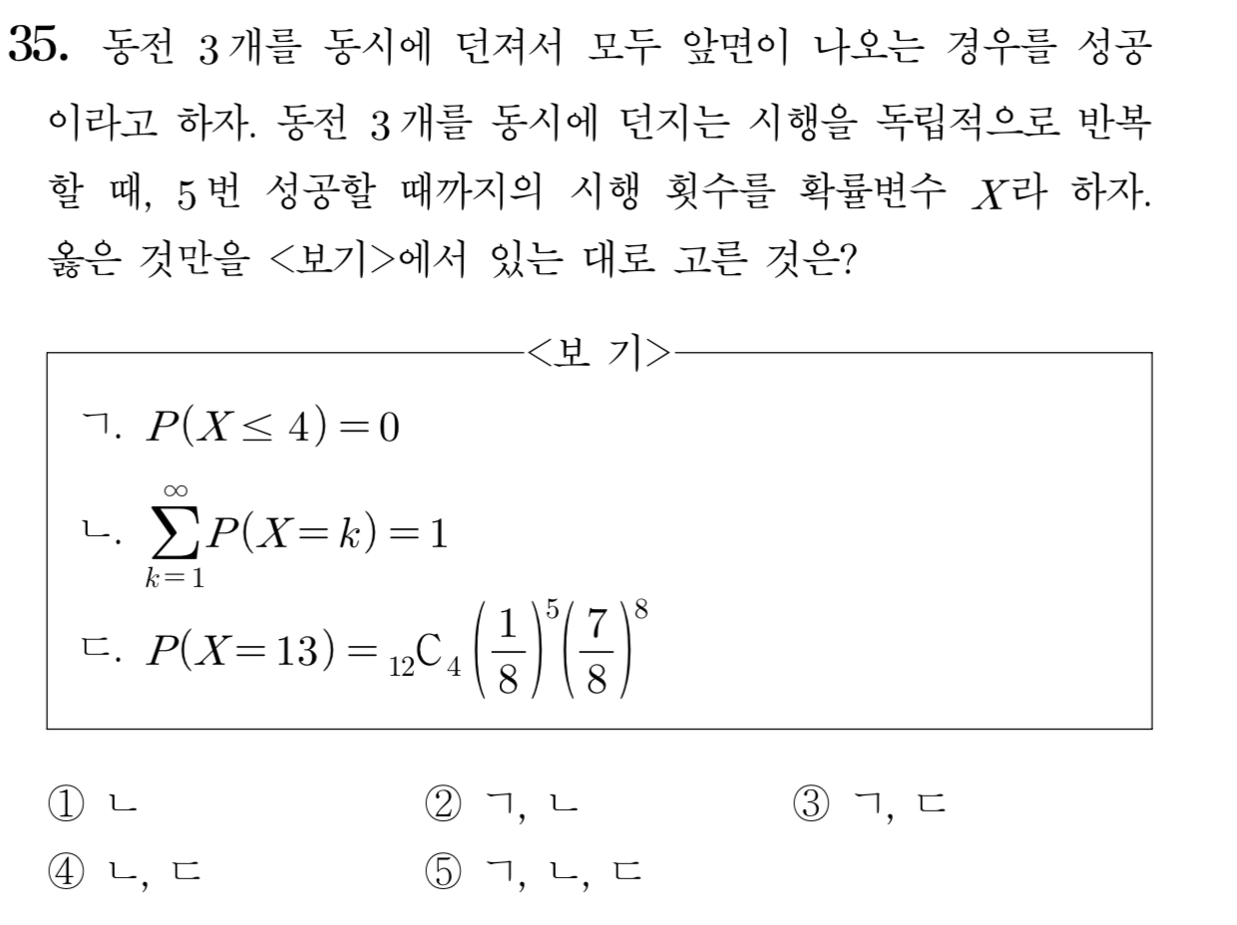
[2013]

Slide 4
